Slide 1
Applied Data Science Capstone Final Project Battle of the Neighborhoods Exploring New York City
By: Dawn Tran
12/05/2020

Slide 2
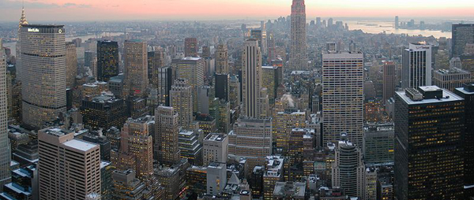
New York City

Slide 3
Business Problem
Due to this demand and the growth of the travel accommodation, Travel agency starting a project of preparing a list of hotels, restaurants, coffee shops along with the name, address, location and the map for their clients. So that their clients can be prepare and know to what to do and where to go when they arrived in New York City – the City that never sleep.
This project is particularly useful for those visitors / tourists that is the first-time visiting New York City or a re-visit after many years.

Slide 4
Data
Data required
List of borough and neighborhoods of New York City
Latitude and Longitude coordinates of those neighborhoods
Venue data, particularly data that related to hotels, restaurants and coffee shops
Sources of data
- Open source dataset of New York City: https://cocl.us/new_York_dataset
- Geocoder package for latitude and longitude coordinates
- Foursquare API for venue data

Slide 5
Methodology
Collect the data from https://cocl.us/new_york_dataset, clean and process the data into a dataframe. Which included neighborhoods, along with latitude and longitude of Manhattan, New York City.
Using FourSquare API, searching the query for a list of hotels, restaurants and coffee shops within 1000 meters around Manhattan area.
Convert the data in to dataframe
Visualize the data into a graph by using python matplotlib libraries

Slide 6
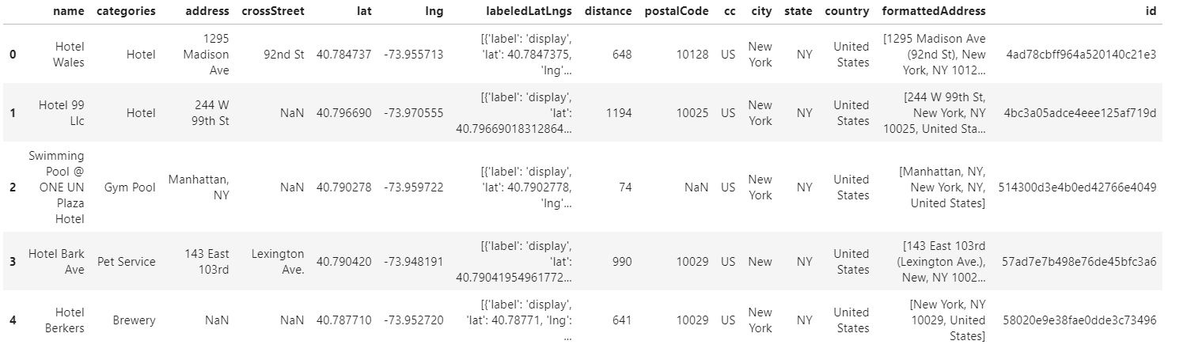
Results - Hotels

Slide 7
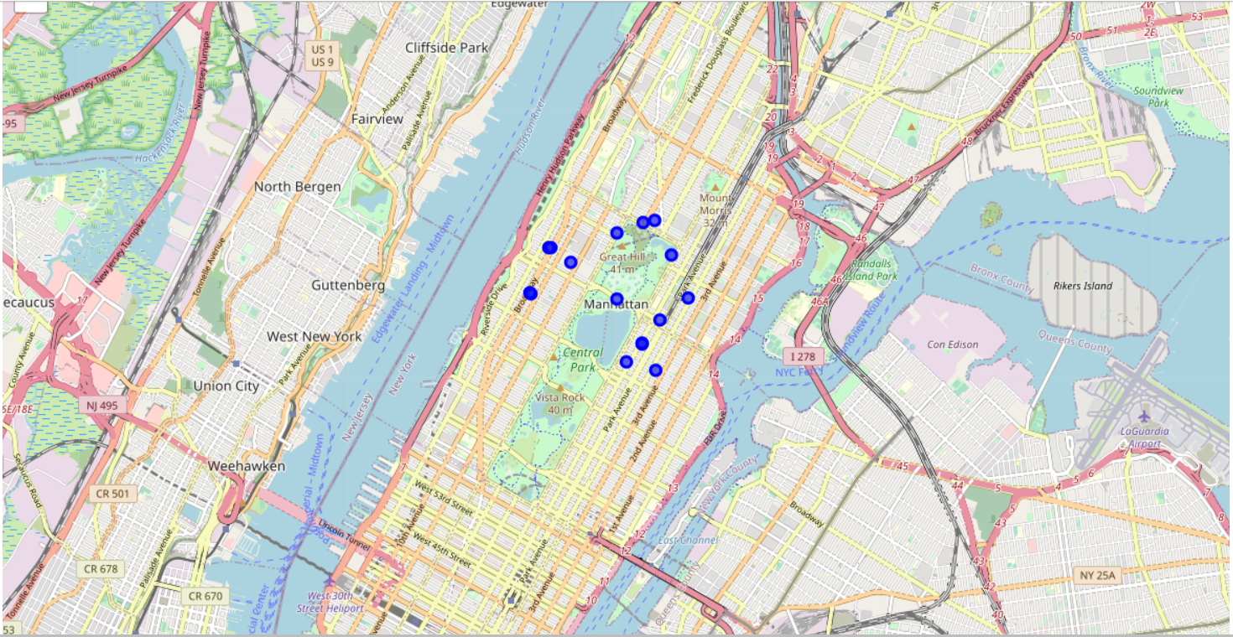
Results – Hotels Graph

Slide 8
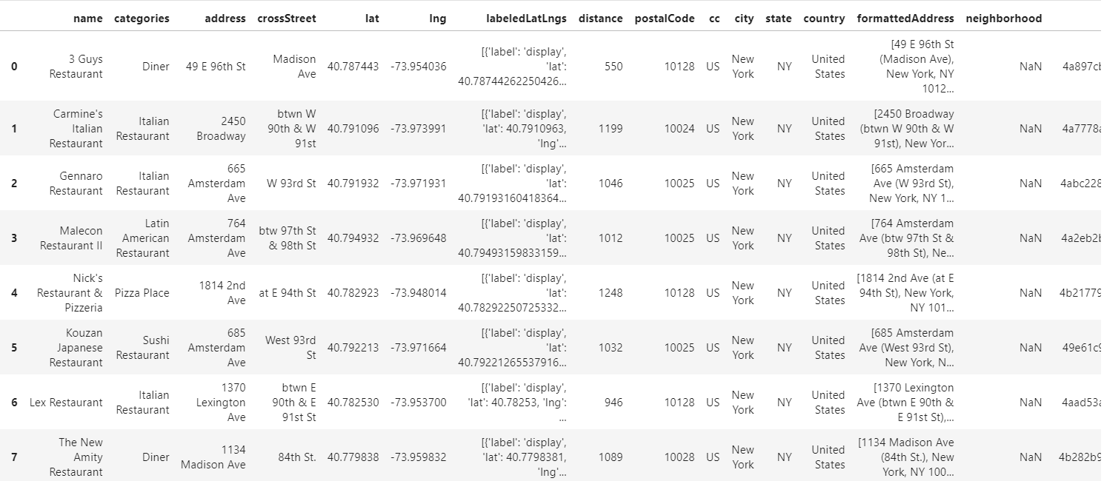
Results - Restaurants

Slide 9
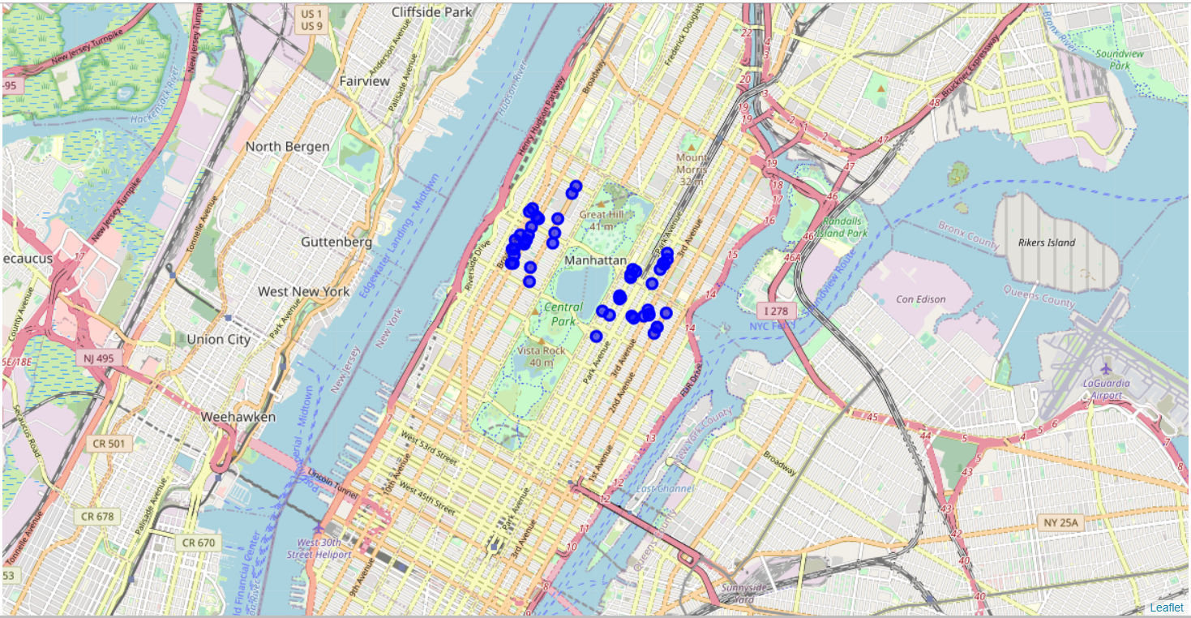
Results – Restaurants Gragh

Slide 10
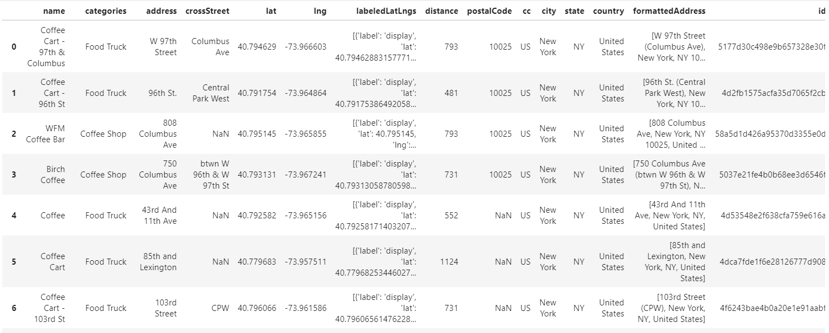
Results – Coffee Shops

Slide 11
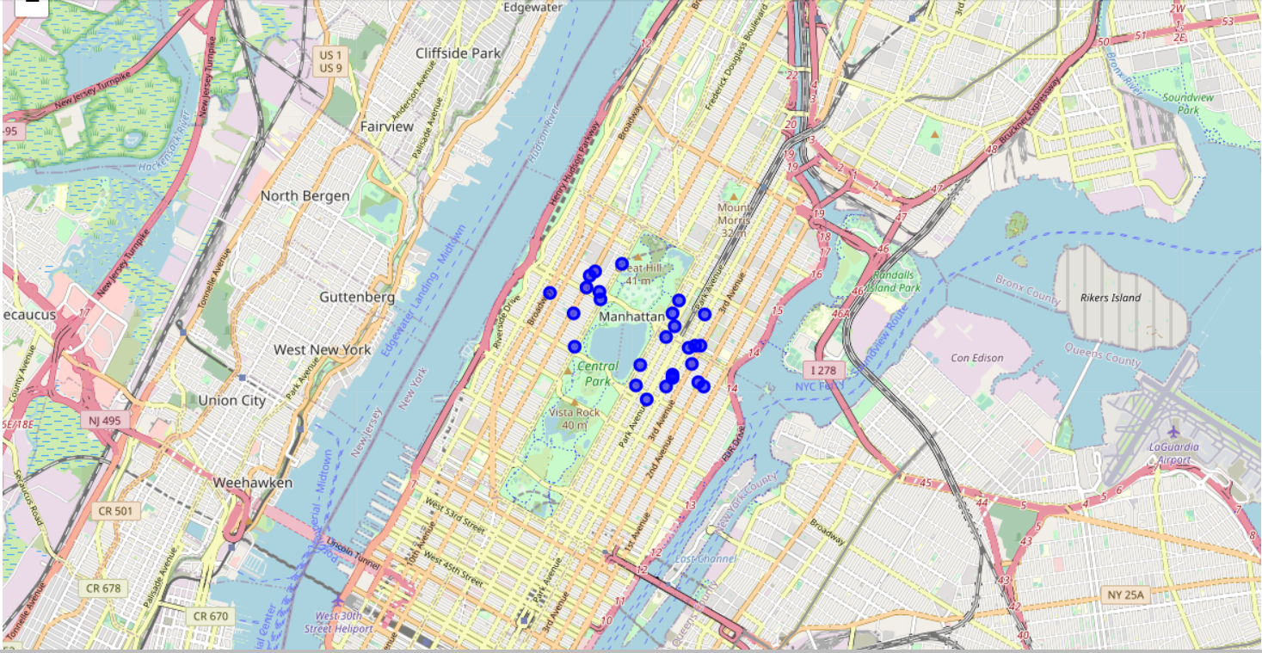
Results – Coffee Shops Graph

Slide 12
Results and Discussion
16 Hotels were found within 1000 meters of the Manhattan, New York City area
50 Restaurants were found within 100 meters around Manhattan, they are all different variety and diversity of the food chains to choose from, such as Japanese, Mexican, Chinese, Italian and etc..
27 Coffee shops were found within 100 meters of Manhattan area
There are plenty of choices for tourists to choose from while they are planning a trip to Manhattan, New York City

Slide 13
Conclusion
With these data, travel agents be able to provide all the information to their clients prior to their trip. Hence, tourists can be able to save some time and efforts from searching information on their own and be able to enjoy their stay and have a great time visiting Manhattan, New York City.

